Slide 1
Mass Storage Structure Lesson 4 RAID
David Liu
Fall 2021, Spring 2022

Slide 2
RAID Structure
RAID – redundant array of inexpensive disks
multiple disk drives provides reliability via redundancy
Increases the mean time to failure
Mean time to repair – exposure time when another failure could cause data loss
Mean time to data loss based on above factors
If mirrored disks fail independently, consider disk with 1300,000 mean time to failure and 10 hour mean time to repair
Mean time to data loss is 100, 000² / (2 ∗ 10) = 500 ∗ 10⁶ hours, or 57,000 years!
Frequently combined with NVRAM to improve write performance
Several improvements in disk-use techniques involve the use of multiple disks working cooperatively

Slide 3
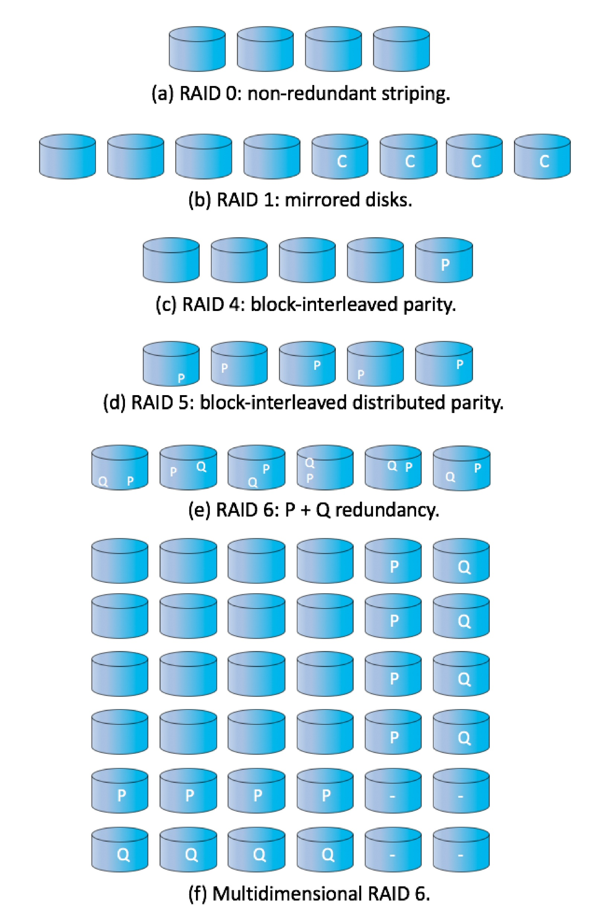
RAID (Cont.)
RAID is arranged into six different levels
RAID 0: non-redundant striping
RAID 1: mirrored disks
RAID 4: block-interleaved parity
RAID 5: block-interleaved distributed parity
RAID 6: P + Q redundancy
Multidimensional RAID 6

Slide 4
RAID Concepts
Striping uses a group of disks as one storage unit
Mirroring or shadowing keeps duplicate of each disk
Block interleaved parity stores the error correction code (ECC) in drive N+1 of previous N blocks of data in drives 1, 2, …, N respectively
Block interleaved distributed parity spreads N data blocks and the ECC block among N+1 drives
Striping: improves performance
Mirroring: provides reliability

Slide 5
RAID (Cont.)
RAID schemes improve performance and improve the reliability of the storage system by storing redundant data
Mirroring or shadowing (RAID 1) keeps duplicate of each disk
Block interleaved parity (RAID 4, 5, 6) uses much less redundancy
RAID within a storage array can still fail if the array fails, so automatic replication of the data between arrays is common
Frequently, a small number of hot-spare disks are left unallocated, automatically replacing a failed disk and having data rebuilt onto them

Slide 6
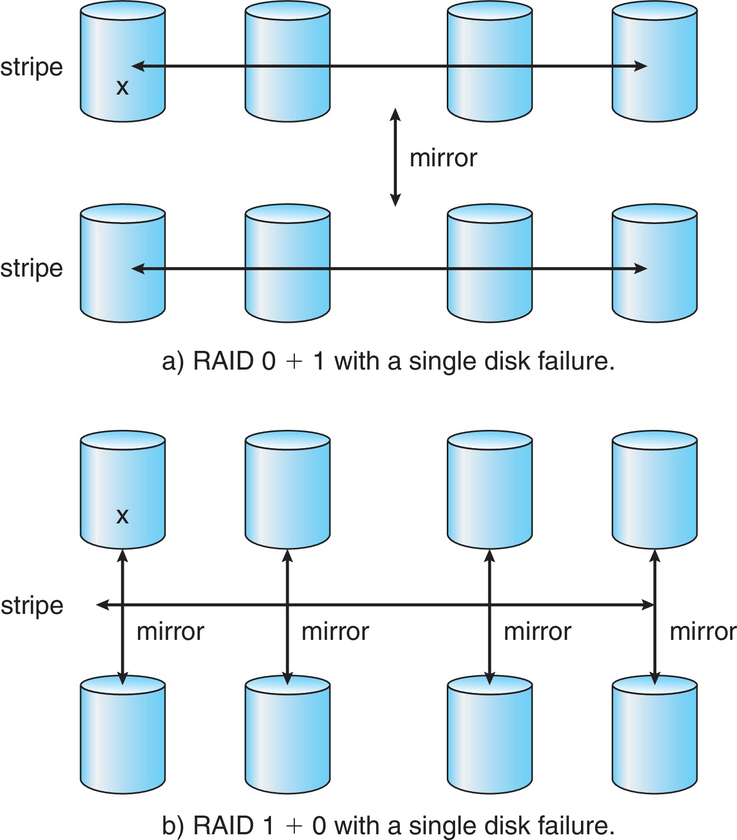
RAID (Cont.)
Striping: improves performance
Mirroring: provides reliability
Striped mirrors (RAID 0+1)
Two redundant stripes available
Single drive failure → entire stripe inaccessible
Mirrored stripes (RAID 1+0)
Only one stripe
Single drive failure→ the stripe uses another mirrored drive
Better performance than RAID 5

Slide 7
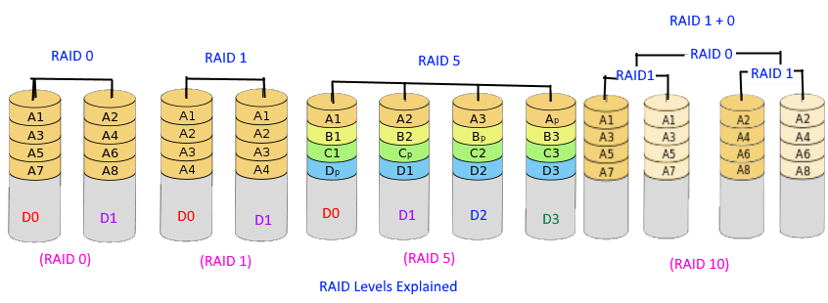
RAID

Slide 8
RAID (Cont.)
RAID schemes improve performance and improve the reliability of the storage system by storing redundant data
Mirroring or shadowing (RAID 1) keeps duplicate of each disk
Striped mirrors (RAID 1+0) or mirrored stripes (RAID 0+1) provides high performance and high reliability
Block interleaved parity (RAID 4, 5, 6) uses much less redundancy
RAID within a storage array can still fail if the array fails, so automatic replication of the data between arrays is common
Frequently, a small number of hot-spare disks are left unallocated, automatically replacing a failed disk and having data rebuilt onto them

Slide 9
Other Features
Regardless of where RAID implemented, other useful features can be added
Snapshot is a view of file system before a set of changes take place (i.e. at a point in time)
More in Ch 12
Replication is automatic duplication of writes between separate sites
For redundancy and disaster recovery
Can be synchronous or asynchronous
Hot spare disk is unused, automatically used by RAID production if a disk fails to replace the failed disk and rebuild the RAID set if possible
Decreases mean time to repair

Slide 10
Traditional and Pooled Storage

Slide 11
Object Storage
General-purpose computing, file systems not sufficient for very large scale
Another approach – start with a storage pool and place objects in it
Object just a container of data
No way to navigate the pool to find objects (no directory structures, few services
Computer-oriented, not user-oriented

Slide 12
Object Storage
Typical sequence
Create an object within the pool, receive an object ID
Access object via that ID
Delete object via that ID
Object storage management software like Hadoop file system (HDFS) and Ceph determine where to store objects, manages protection
Typically by storing N copies, across N systems, in the object storage cluster
Horizontally scalable
Content addressable, unstructured

